Slide 1
Methodology documentation: Machine Learning for SEM Image Enhancement
Umesh Adiga
01/14/2022
Highly Confidential

Slide 2
ImAGE SUPER RESOLUTION AND NOISE REDUCTION
Image super-resolution (SR) is the process of recovering high-resolution (HR) images from low-resolution (LR) images. It is an important class of image processing techniques in computer vision and image processing and enjoys a wide range of real-world applications, such as medical imaging, satellite imaging, surveillance and security, astronomical imaging, amongst others.
Image super-resolution (SR) problem, particularly single image super-resolution (SISR), has gained a lot of attention in the research community. SISR aims to reconstruct a high-resolution image ISR from a single low-resolution image ILR. Generally, the relationship between ILR and the original high-resolution image IHR can vary depending on the situation. Many studies assume that ILR is a bicubic down-sampled version of IHR, but other degrading factors such as blur, decimation, or noise can also be considered for practical applications. Interpolation-based methods such as nearest-neighbor, bilinear, splines, etc., often introduce some side effects such as computational complexity, noise amplification, blurring results, etc., that are no longer the factors in deep-learning based non-linear methods to achieve super resolution.

Slide 3
Electron Microscopy image noise
Electron microscopy images are very noisy. As the resolution increases, signal to noise ratio (SNR) becomes poorer. In addition, longer exposure to reduce the noise is not feasible due to stage movement that introduces motion blur in the image.
To avoid the motion blur, conventional approach is to collect many images with a shortest possible exposure time where the stage motion effect can be ignored and register those images with some correlation method and average the pixels that are common to all the images. This averaged image constitute to one single image with high SNR.
Unfortunately, multiple exposure of the specimens to electron beam damages the specimen. Each short exposure image frames may differ in statistical features although they are imaging the same specimen. This degrades the image quality. Is there a way to reduce the noise level in short exposure image frames and use only a few imge frames to average that can significantly increase the SNR of the image.

Slide 4
Why this proposal
Customer complaints about image quality
Poor Image Quality
1. Image appearance or visual quality (example: poor SNR, CNR, uniformity, resolution, etc.)
Better visual quality to help marketing/sales and add psychological perception that our machines are performing better. May facilitate better metrology too.
2. Image information content (example: lack of material distinction in 3DNAND, etc.)
Most important quality and this require combination of hardware and improved image reconstruction software
3. Amenability to precision metrology (example: inability to facilitate high throughput precision)
More ambiguous. Depends on what you are measuring.
In this work we are dealing with the first topic, namely, “Image appearance or visual quality”

Slide 5
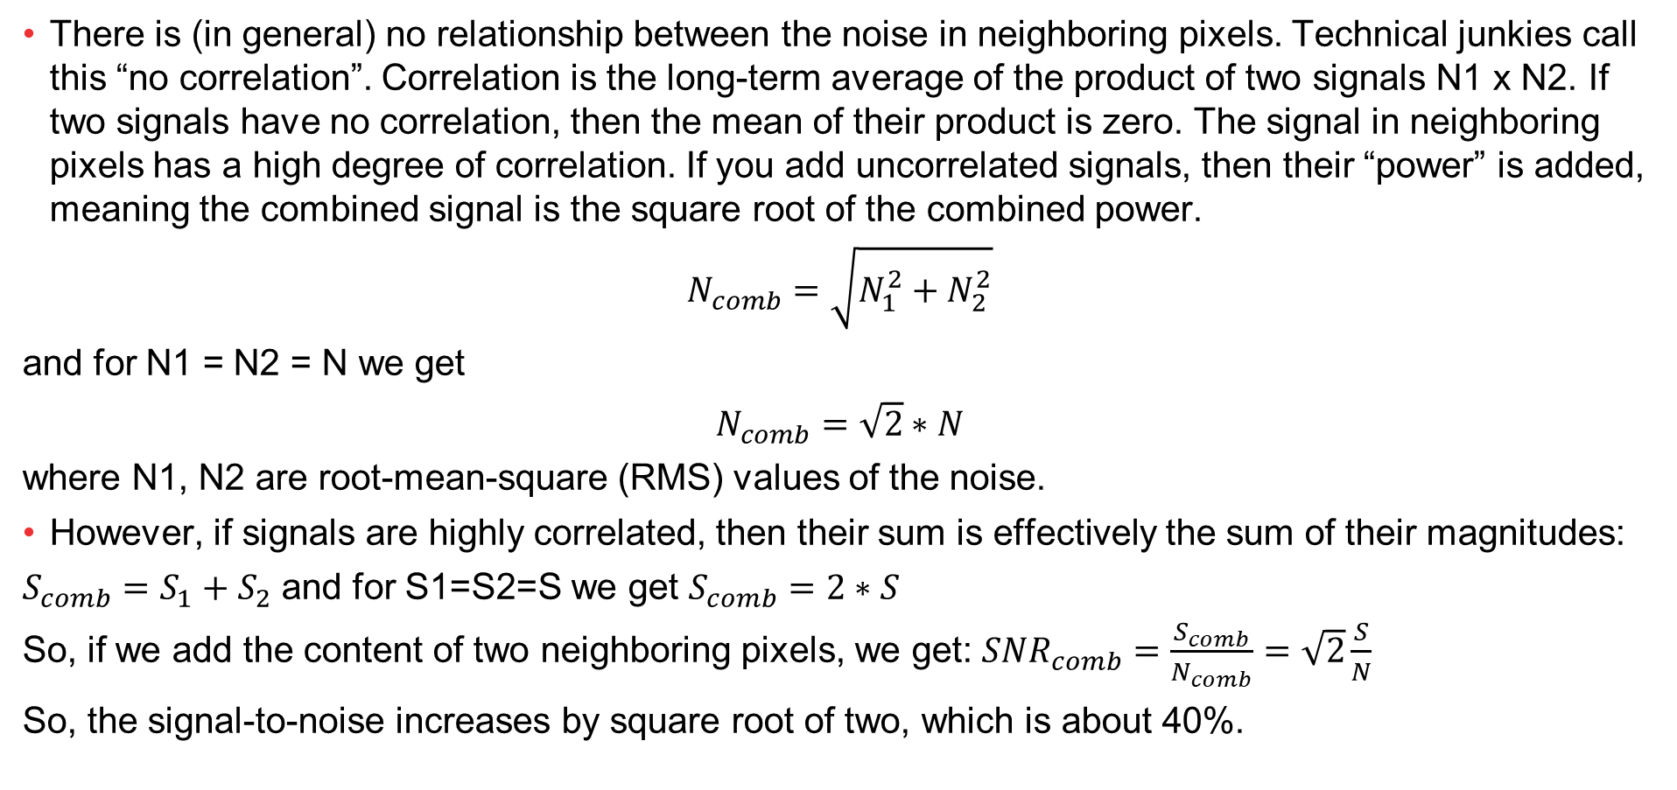
Super resolution for noise reduction????
There is (in general) no relationship between the noise in neighboring pixels. Technical junkies call this “no correlation”. Correlation is the long-term average of the product of two signals N1 x N2. If two signals have no correlation, then the mean of their product is zero. The signal in neighboring pixels has a high degree of correlation. If you add uncorrelated signals, then their “power” is added, meaning the combined signal is the square root of the combined power.
$$N_{comb}=\sqrt{N_{1}^{2}+N_{2}^{2}}$$
and for N1 = N2 = N we get
$$N_{comb}=\sqrt{2}∗N$$
where N1, N2 are root-mean-square (RMS) values of the noise.
However, if signals are highly correlated, then their sum is effectively the sum of their magnitudes:
$S_{comb}=S_{1}+S_{2}$ and for S1=S2=S we get $S_{comb}=2∗S$
So, if we add the content of two neighboring pixels, we get: ${SNR}_{comb}=\frac{S_{comb}}{N_{comb}}=\sqrt{2}\frac{S}{N}$
So, the signal-to-noise increases by square root of two, which is about 40%.

Slide 6
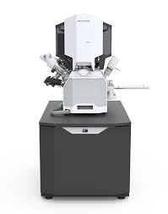
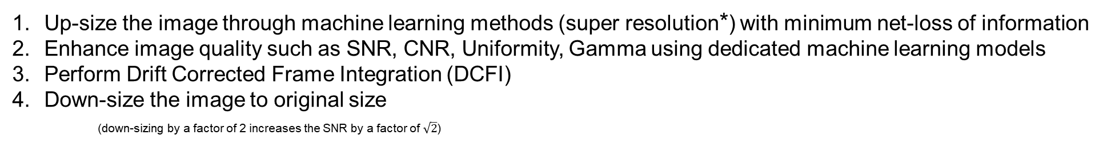
In general: Super Resolution Noise Reducer (SRNR) model
Up-size the image through machine learning methods (super resolution*) with minimum net-loss of information
Enhance image quality such as SNR, CNR, Uniformity, Gamma using dedicated machine learning models
Perform Drift Corrected Frame Integration (DCFI)
Down-size the image to original size
(down-sizing by a factor of 2 increases the SNR by a factor of $\sqrt{2}$)
SRNR model
Machine Learning Models to re-size the image-frame
Machine Learning Models to enhance the image-frame quality
Drift Corrected
Frame Integration
(DCFI)
Image frames
(4-to-N)
Image down-size
to original size
To metrology
*Super resolution does not improve “resolution” of the original input image

Slide 7
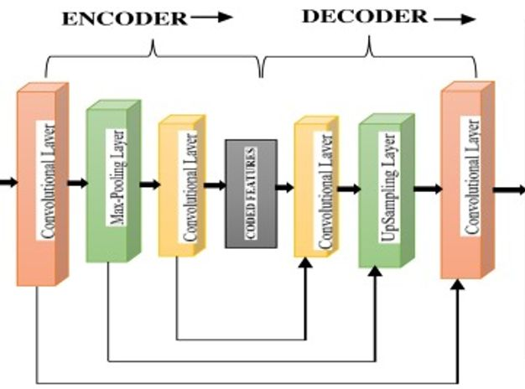
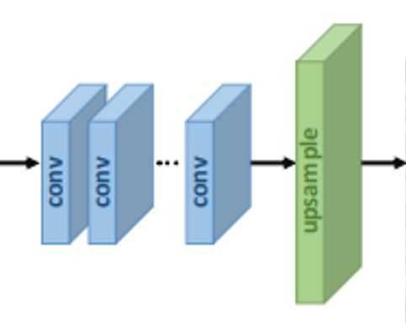
Proposed Architecture for Neural Network: NRSR model
Image frames
DCFI
Down-size
Noise Reduction(NR)
Super Resolution(SR)

Slide 8
Super Resolution Model Architecture
Image frames
DCFI
Down-size
Super Resolution

Slide 9
Code snippet of super resolution model (Using Tensorflow, Keras)
##Some required parameters that define the deep-learning network
num_filters=32
num_res_blocks=8
res_block_scaling=None
scale=4
########## Let us do ML based 4X super-resolution enhancement here ###################
x_in = Input(shape=(None, None, 1))
x = Lambda(normalize)(x_in)
x = b = Conv2D(num_filters, 3, padding='same')(x)
for i in range(num_res_blocks):
b = res_block(b, num_filters, res_block_scaling)
b = Conv2D(num_filters, 3, padding='same')(b)
x = Add()([x, b])
x = upsample(x, scale, num_filters)
x = Conv2D(3, 3, padding='same')(x)
x = Lambda(denormalize)(x)
#################################################################################
sr= Model(x_in, x, name="sr")
sr.compile(optimizer='adam', loss='mse', metrics=['accuracy'])
early_stopper = EarlyStopping(monitor='val_loss', min_delta=0.1, patience=50, verbose=1, mode='min')
model_checkpoint = ModelCheckpoint('super_resolution_checkpoint.h5', save_best_only = True)
#train
sr.fit(x_train, y_train, epochs=1000, validation_data=(x_valid, y_valid), callbacks=[early_stopper, model_checkpoint])
autoencoder.save("D:\\myData\\ML_Quality\\super_resolution_SR.h5")

Slide 10
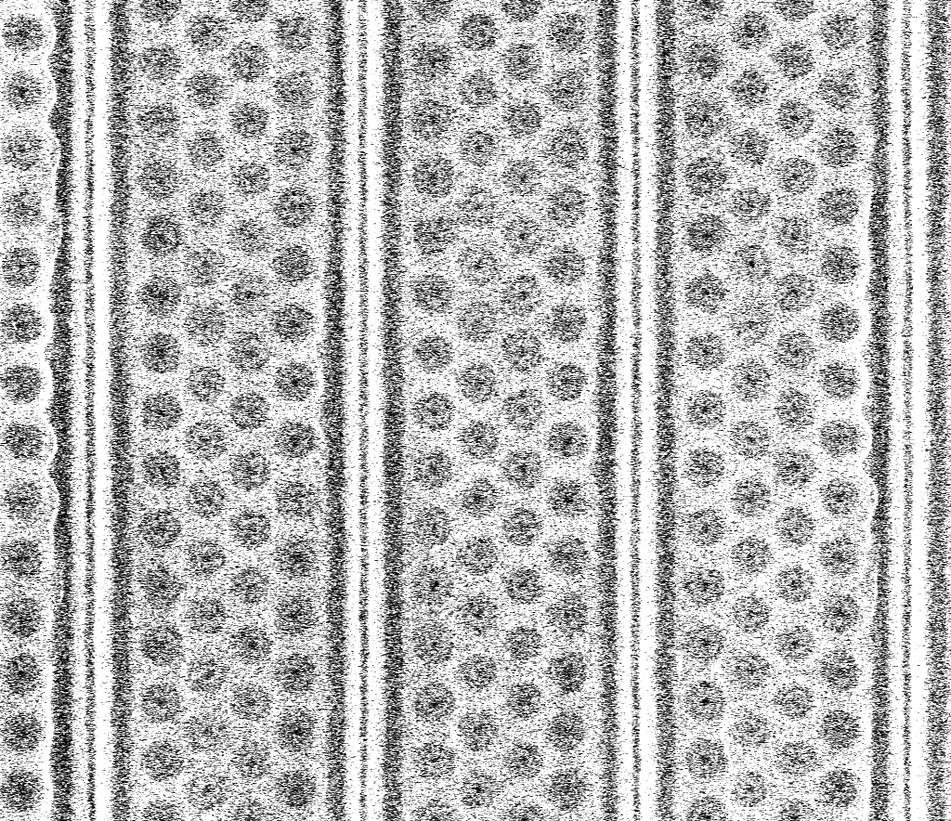
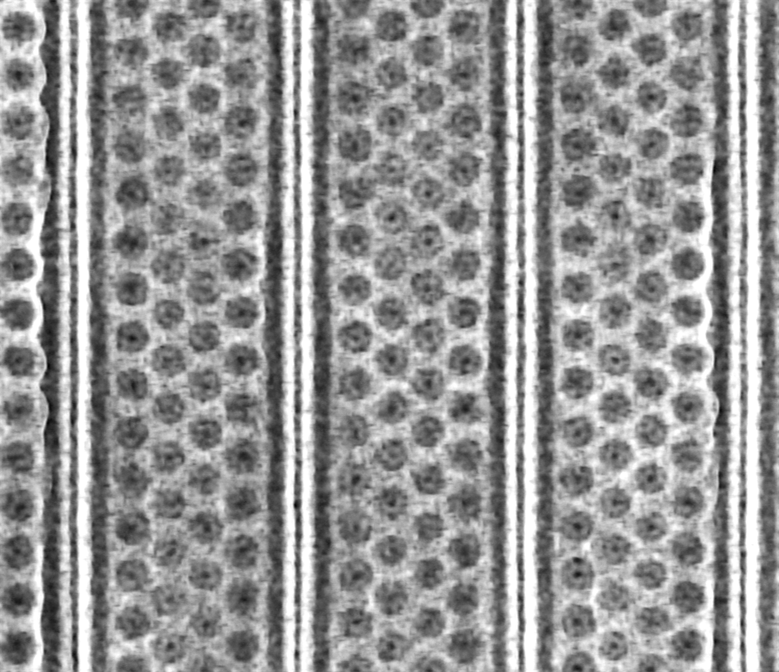
Individual Image Frame Super Resolution (SR) model: 3D NAND (Verios SEM) trained
Original Single Frame
After super resolution enhancement
Multiple frames (of very low dwell time) are enhanced by SR model prior to DCFI

Slide 11
DCFI of image frames before and after SR model application:
Before
After
We will rework the SR training to reduce the amount of blur

Slide 12
Conclusion on SR model enhancement
Noise reduction in individual image frames is significant
Super resolved image has 4X more pixel count and hence easier for metrology algorithm deployment
Transition from one brightness level to another is smooth and somewhat sharp.
Result images appear to be darker in overall brightness. Either the training data should be modified to enhance the image brightness or use a conventional post-processing algorithm to enhance the image brightness.
Images appeared to be somewhat blurred. Retraining with sharp images might reduce this effect.

Slide 13
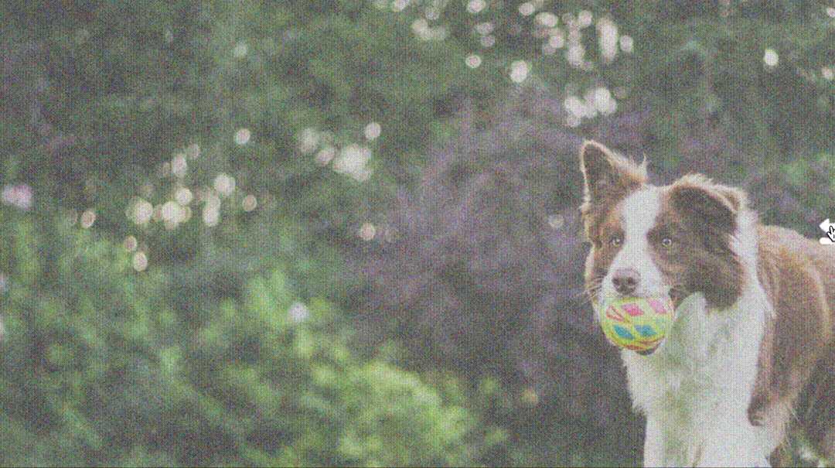
Proposal for Noise Reducer Model
For every image-frame, use auto-encoder decoder models
to improve SNR, CNR, uniformity, gamma correction, etc.
Machine learning model here would consist of
1. Auto-encoders and
2. Auto-decoders
Accomplishes
1. Noise reduction,
2. Contrast and Brightness standardization and
3. Gama correction
Contd.

Slide 14
Code snippet- Autoencoder Decoder Model:
########## Let us do ML based enhancement here ###################
img = Input(shape=(None, None, 1))
############### let’s create the model with an object call ###################
#encoding architecture
x1 = Conv2D(4, (3, 3), activation='relu', padding='same', kernel_regularizer=regularizers.l1(10e-10))(img) #64
x2 = Conv2D(4, (3, 3), activation='relu', padding='same', kernel_regularizer=regularizers.l1(10e-10))(x1) #64
x3 = MaxPool2D(padding='same')(x2)
x4 = Conv2D(8, (3, 3), activation='relu', padding='same', kernel_regularizer=regularizers.l1(10e-10))(x3) #128
x5 = Conv2D(8, (3, 3), activation='relu', padding='same', kernel_regularizer=regularizers.l1(10e-10))(x4) #128
x6 = MaxPool2D(padding='same')(x5)
x7 = Conv2D(16, (3, 3), activation='relu', padding='same', kernel_regularizer=regularizers.l1(10e-10))(x6) #128
x8 = Conv2D(16, (3, 3), activation='relu', padding='same', kernel_regularizer=regularizers.l1(10e-10))(x7) #128
x9 = MaxPool2D(padding='same')(x8)
encoded = Conv2D(32, (3, 3), activation='relu', padding='same', kernel_regularizer=regularizers.l1(10e-10))(x9) #256
## decoding architecture
y7 = UpSampling2D()(encoded)
y8 = Conv2D(16, (3, 3), activation='relu', padding='same', kernel_regularizer=regularizers.l1(10e-10))(y7) #128
y9 = Conv2D(16, (3, 3), activation='relu', padding='same', kernel_regularizer=regularizers.l1(10e-10))(y8) #128
y10 = Add()([x8, y9])
y11 = UpSampling2D()(y10)
y12 = Conv2D(8, (3, 3), activation='relu', padding='same', kernel_regularizer=regularizers.l1(10e-10))(y11) #128
y13 = Conv2D(8, (3, 3), activation='relu', padding='same', kernel_regularizer=regularizers.l1(10e-10))(y12) #128
y14 = Add()([x5, y13])
y15 = UpSampling2D()(y14)
y16 = Conv2D(4, (3, 3), activation='relu', padding='same', kernel_regularizer=regularizers.l1(10e-10))(y15) #64
y17 = Conv2D(4, (3, 3), activation='relu', padding='same', kernel_regularizer=regularizers.l1(10e-10))(y16) #64
y18 = Add()([x2, y17])
y19 = Conv2D(32, (3, 3), padding='same', kernel_regularizer=regularizers.l1(10e-10))(y18) #32
decoded = Conv2D(1, (3, 3), padding='same',activation='relu', kernel_regularizer=regularizers.l1(10e-10))(y19)
autoencoder = Model(img, decoded)
autoencoder.compile(optimizer='adam', loss='mse', metrics=['accuracy'])
early_stopper = EarlyStopping(monitor='val_loss', min_delta=0.1, patience=50, verbose=1, mode='min')
model_checkpoint = ModelCheckpoint('noise_reducer_checkpoint.h5', save_best_only = True)
#train
#epoch=1 is just to show the code works as my home-PC is not capable of running large training datasets through many epochs
autoencoder.fit(x_train, xy_train, epochs=1, validation_data=(x_valid, xy_valid), callbacks=[early_stopper, model_checkpoint])
#Actual saved model is from company computing environment where epochs=100 is used to fit the training data
autoencoder.save("D:\\myData\\ML_Quality\\autoencoder_NR.h5")

Slide 15
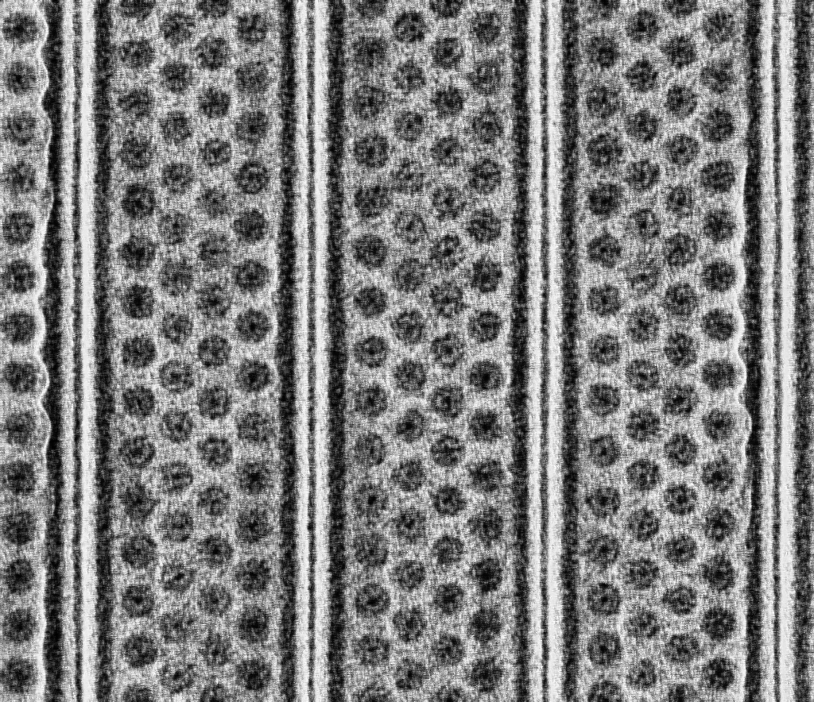
Individual Image Frame Noise Reducer (NR) model: 3D NAND (Verios SEM) trained
Original Single Frame
After super resolution enhancement
Multiple frames (of very low dwell time) are enhanced by NR model prior to DCFI

Slide 16
Image before and after NR model application(reintroducing low-level noise to “after” result from original data):
Using original image frames only
Using original + improved image frames
Image frames from both before and after the application of super resolution are used to construct a single DCFI image. This is intentionally done to reintroduce
characteristic SEM noise to the final image at a low level to get a better “appearance”.
If you zoom 200%, you will see pixel level effect of super resolution

Slide 17
Conclusions on the Noise Reducer Model:
Noise reducer model when applied on original image frames has performed well
Fast training and fast execution make this model more attractive.
Some experiment in reworking the model might be necessary to reduce the blur and reduce large
contrast variation possibilities.
Appears to carry forward image artifacts. Should be reworked and retrained to reduce this.

Slide 18
Using whole model
Image frames
DCFI
Down-size
Super Resolution
Noise Reduction
Resulting images are in next few slides.
This is a first attempt.
We have a clear path to rework and get better results

Slide 19
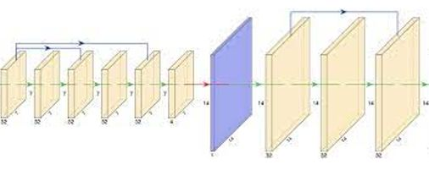
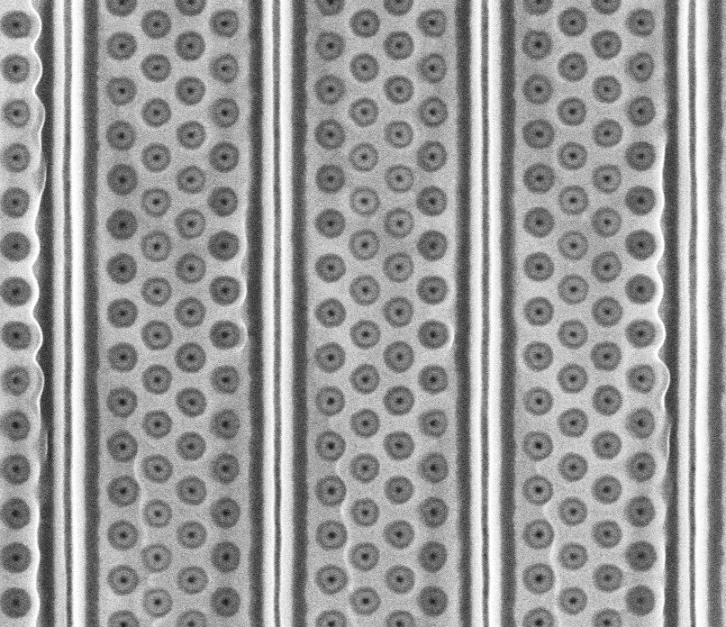
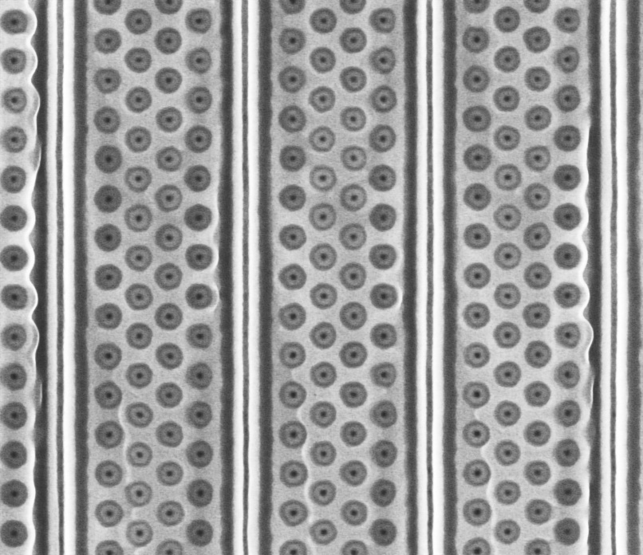
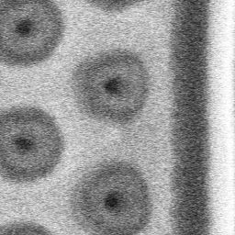
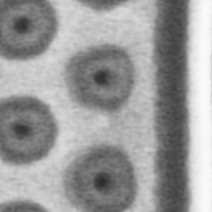
Idea
ML network
Downsize
By
Cubic Splines
DCFI
Low dwell image frames
DCFI
Super-resolved image frames

Slide 20
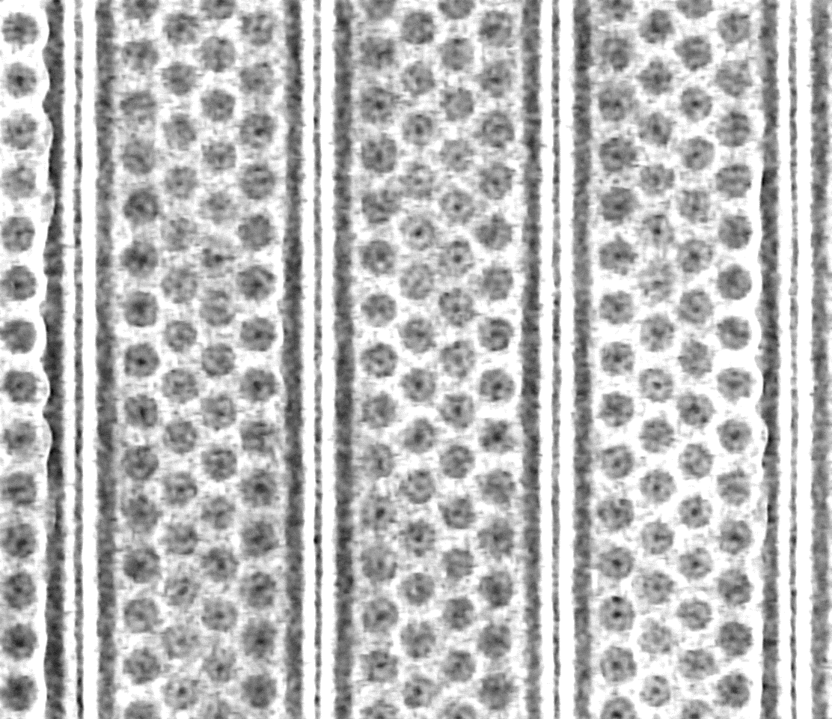
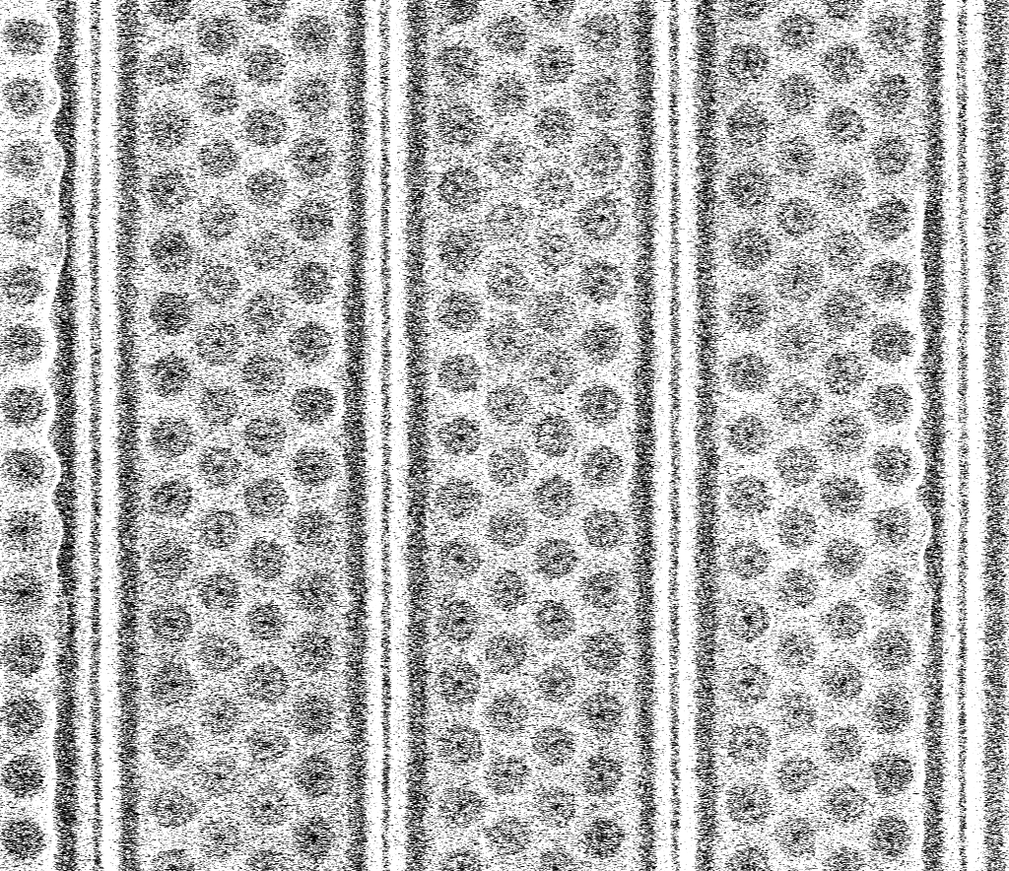
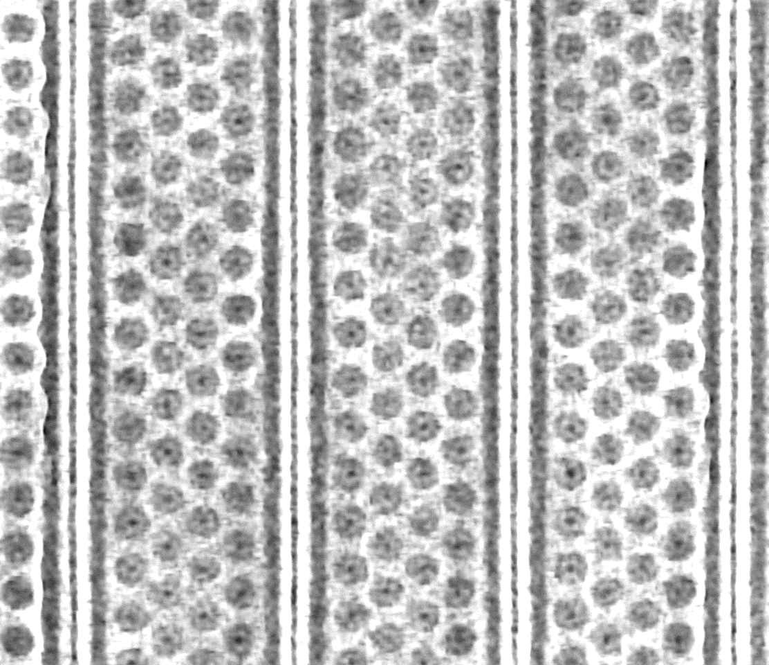
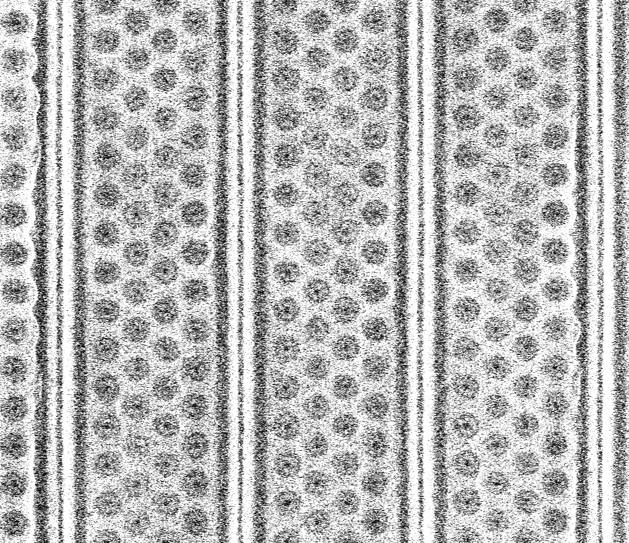
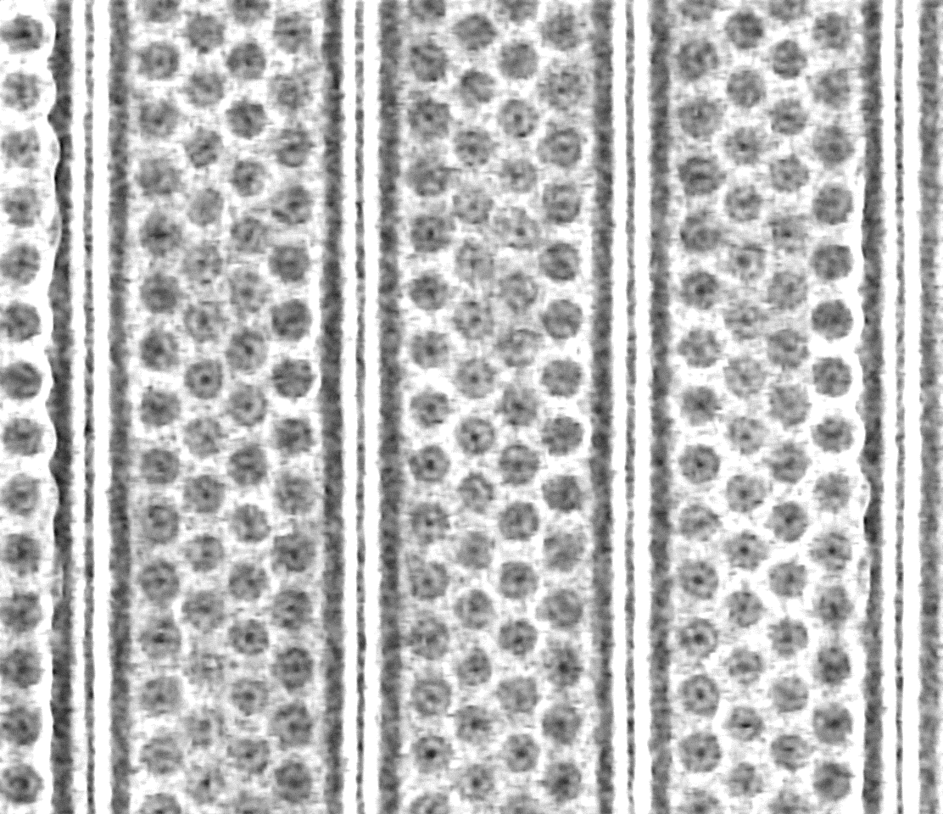
Individual Image Frame Super Resolution (SR) model: 3D NAND (Verios SEM) trained
Original Frames
After super resolution enhancement

Slide 21
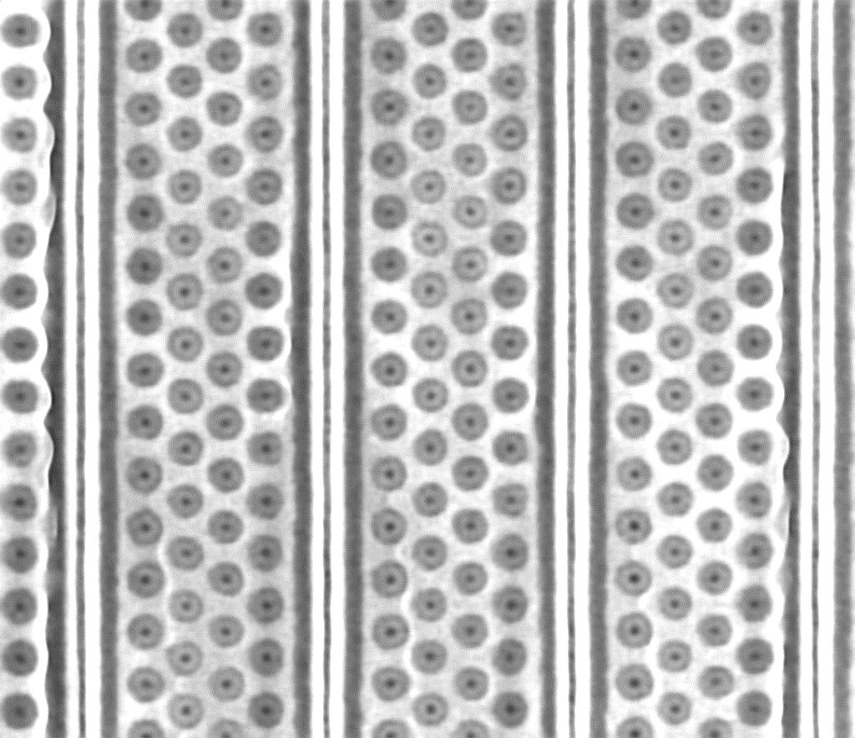
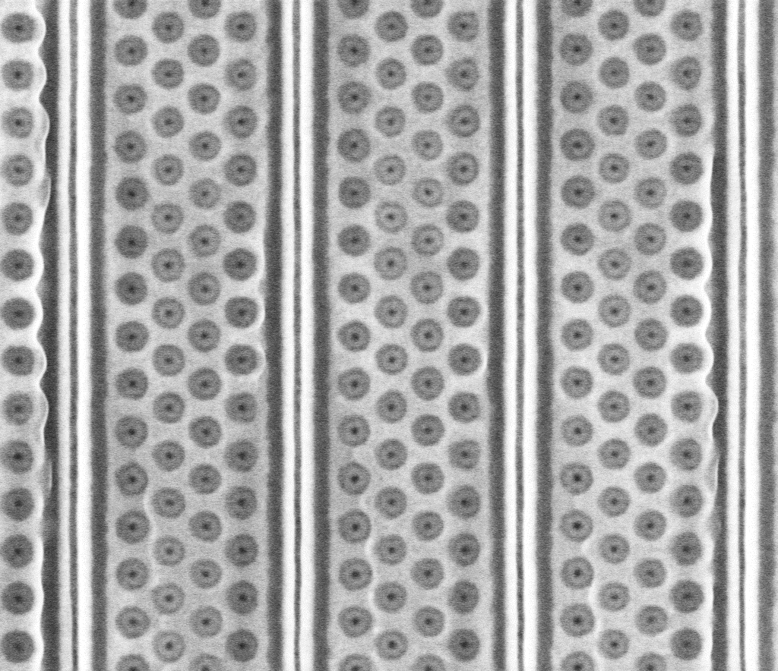
DCFI of image frames before and after SR model application:
Before super resolution
Image frames from both before and after the application of super resolution are used to construct a single DCFI image. This is intentionally done to reintroduce characteristic SEM noise to the final image at a low level to get a better “appearance”.
After super resolution
Using original + improved image frames

Slide 22
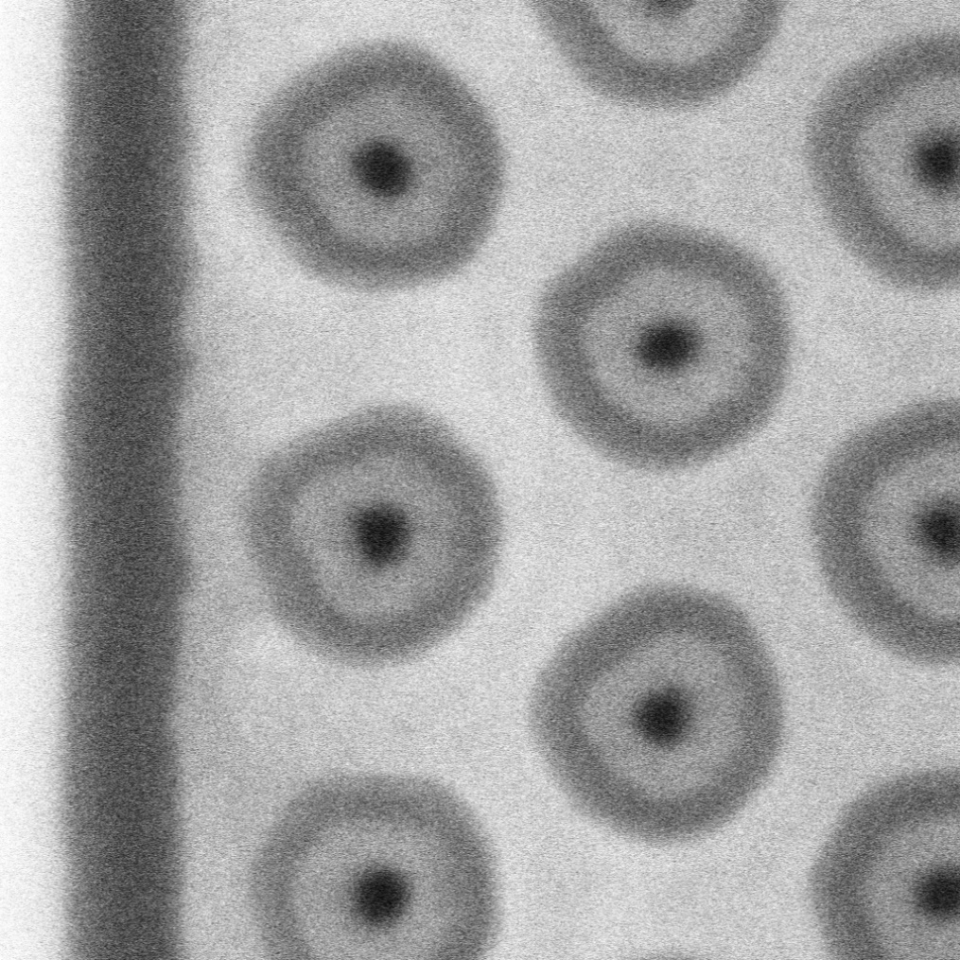
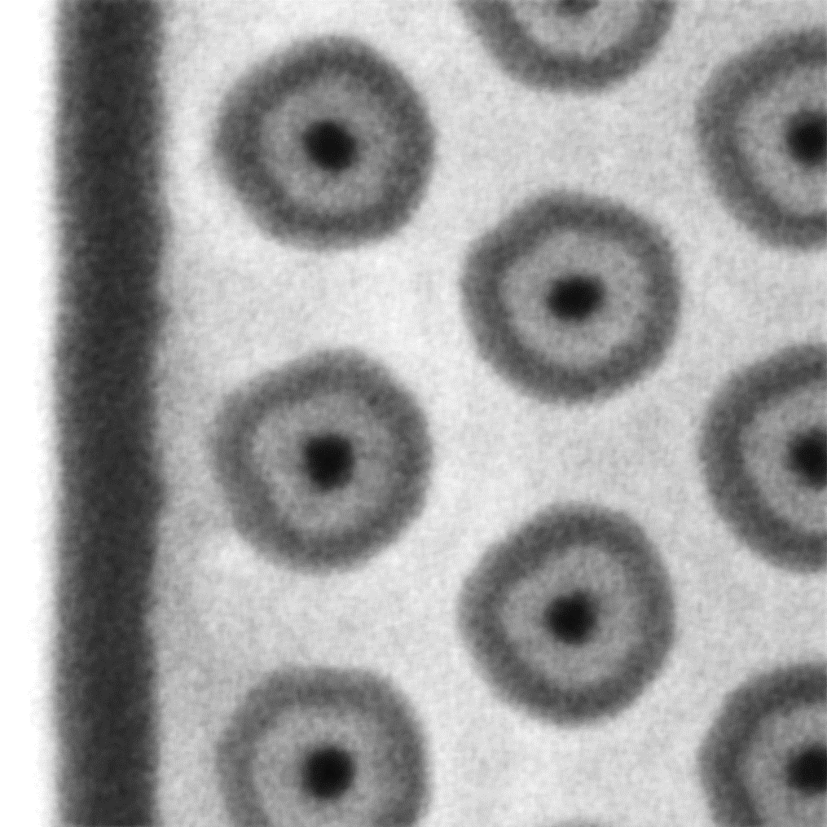
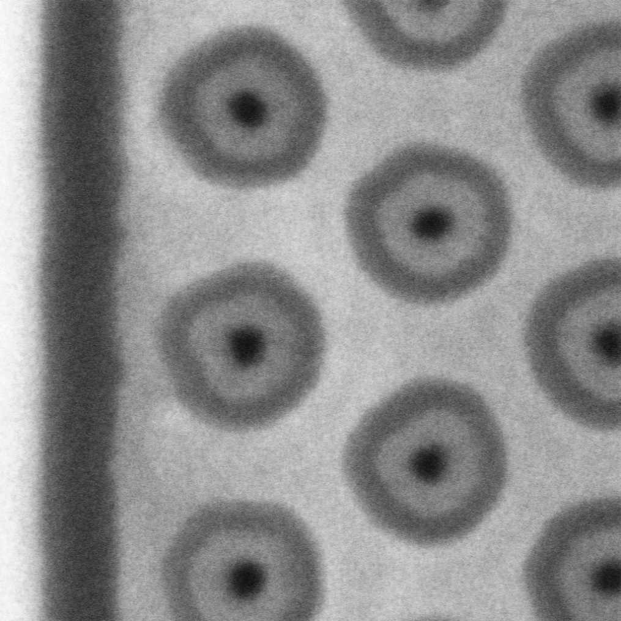
Image before and after SRNR model application:
Before super resolution
After super resolution
Using original + improved image frames
Image frames from both before and after the application of super resolution are used to construct a single DCFI image. This is intentionally done to reintroduce characteristic SEM noise to the final image at a low level to get a better “appearance”.

Slide 23
Conclusions (for version -2.0)
NRSR results can be improved further
Individual SR modelling or NR modelling appear to have achieved equal or better results.
Training to be done on high quality image data
Different models are to be reconstructed for different resolution (as in the image acquisition GUI menu)
More research will be done to reduce blurring
Different super resolution models will be tested in the coming days
May end-up choosing only SR model or only NR model as a sufficient process instead of SRNR or NRSR pipelines that are memory and time consuming.

